Slide 1
KSP Crime Intelligence & Analytical Platform
KSP Datathon 2026
AI-Driven Crime Analytics & Visualization Platform · Karnataka State Police SCRB
TEAM DETAILS
Team Name
Hashiras
Team Leader
Athreya S P
Team Size
Five Members
Problem Statement
AI-Driven Crime Analytics & Visualization Platform
Platform
Zoho Catalyst — Serverless Cloud
Stack
React · TypeScript · Vite · TanStack Router · Node.js

Slide 2
Brief about the Solution
KSP Crime Intelligence & Analytical Platform
A centralized intelligence web portal for the Karnataka State Police SCRB that combines:
▸ Hex-grid Cartogram Dashboard — interactive district FIR density map with 30-day trend
▸ Crime Hotspot Mapping — MapLibre GL spatial heatmap with radius/intensity controls
▸ Criminal Network & Link Analysis — D3-force graph of offender connections across cases
▸ Offender Registry — searchable suspect dossier with mugshots stored in Catalyst File Store
▸ AI-Based Predictive Crime Insights — ML-style forecasting by hour, district, and crime head
▸ Sociological Profiling — demographic breakdowns (age, gender, religion, caste, occupation)
▸ Digital Case Dossier & FIR Repository — full CRUD with PDF print export via jsPDF
▸ New FIR Intake — structured form that writes to 27 Catalyst Datastore tables in one POST
All data is fetched live from Zoho Catalyst Datastore via ZCQL. Mock data fills in when the serverless function is offline.

Slide 3
Opportunities
Differentiation · Problem Solving · USP
HOW IT IS DIFFERENT
HOW IT SOLVES THE PROBLEM
USP
▸ Existing CCTNS/FIR systems store records — we deliver intelligence
▸ Detects crime hotspots at district & sub-district level
▸ Designed specifically for SCRB intelligence workflows
▸ Combines spatial, relational & predictive analysis in one SPA
▸ Identifies links between offenders and cases (network graph)
▸ Unified hotspot map, network graph & AI predictions
▸ Real cartogram (hex grid) + live ZCQL queries vs static reports
▸ Predicts future crime trends by hour, day & location
▸ Fully serverless on Zoho Catalyst (27 Datastore tables)
▸ Framer Motion micro-animations for command-centre feel
▸ Supports proactive policing & faster decision-making
▸ jsPDF printable FIR copies with QR codes
▸ Officers file new FIRs directly from the portal
▸ Live Catalyst File Store for mugshots & officer photos

Slide 4
Features of the Solution
CORE MODULES
INTELLIGENCE & ANALYTICS
▸ Overview Dashboard — KPI cards (Total FIRs, Heinous %, Active, Charge-sheeted, Arrests)
▸ Criminal Network Graph — D3-force, filter by offense or year
▸ Hex Cartogram — clickable district hexes coloured by FIR density, spike badges
▸ Offender Registry — paginated table with mugshot, search, jurisdiction filter
▸ Radial 24h Timeline — hour-of-day ring chart for selected district
▸ Predictive AI Engine — hour / district / crime-head forecasts with confidence bars
▸ 30-Day Trend Bar — mini histogram for recent FIR volume
▸ Sociological Analysis — age pyramid, gender split, religion/caste/occupation pie charts
▸ Crime Head Donut — category breakdown for selected district
▸ Cases Explorer — full FIR search, filter by gravity/status/district
▸ Hotspot Map — MapLibre GL heatmap with radius/intensity sliders
▸ Case Dossier — complainant, victim, accused, legal sections, chargesheet, PDF print
▸ New FIR Form — multi-step intake that POSTs to Catalyst Datastore across 27 tables

Slide 5
Process Flow / Use-case Diagram
End-to-end data flow from Karnataka Police FIR registration to intelligence output:
Field Officer Files FIR
New FIR Form (React SPA)
Catalyst Serverless API (Node.js)
Catalyst Datastore (27 Tables)
ZCQL Live Queries
Analytics Engine (React)
SCRB Officer Dashboard
→
→
→
→
→
→
▸ FIR filed via structured React multi-step form → POST /server/api/cases
▸ Serverless function inserts records across CaseMaster, Accused, Victim, Complainant, ArrestSurrender, ActSectionAssociation, ChargesheetDetails + 20 lookup tables
▸ Frontend fetches via GET /server/api/cases using ZCQL; falls back to deterministic mock data when offline
▸ Analytics views (hotspots, network, predictive, sociological) consume the same live Case[] array

Slide 6
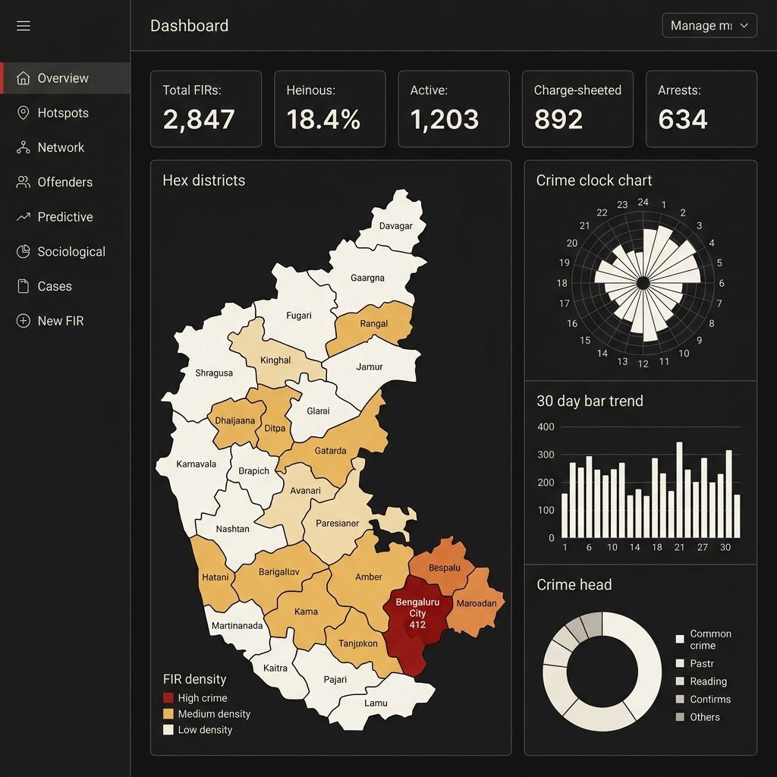
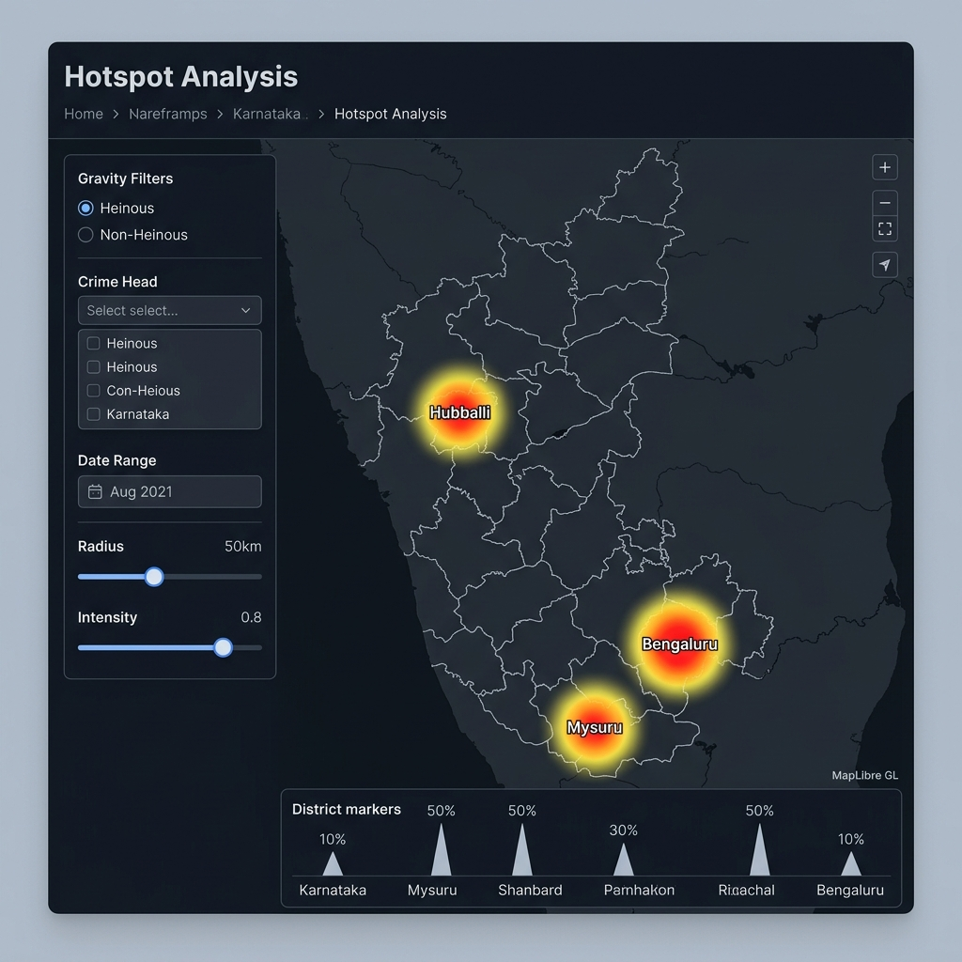
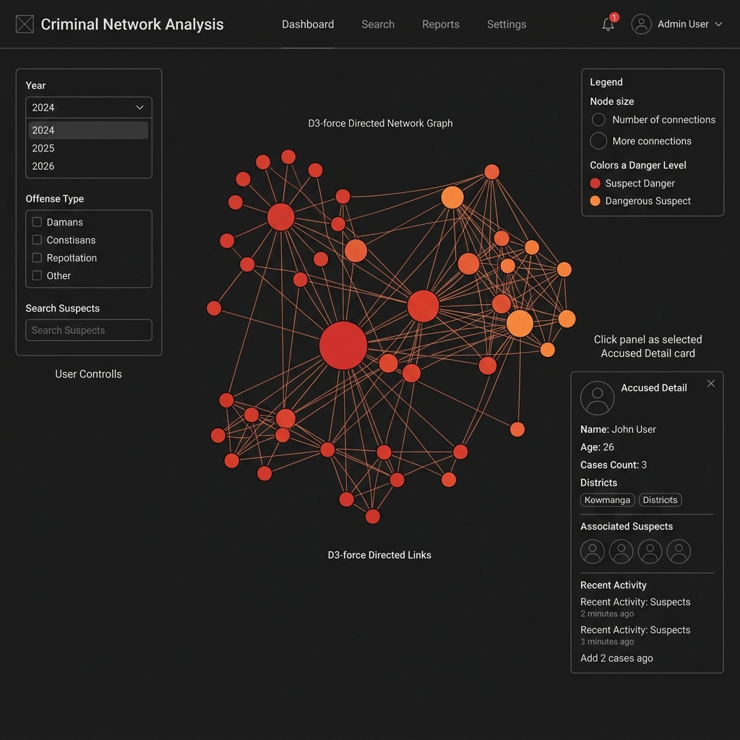
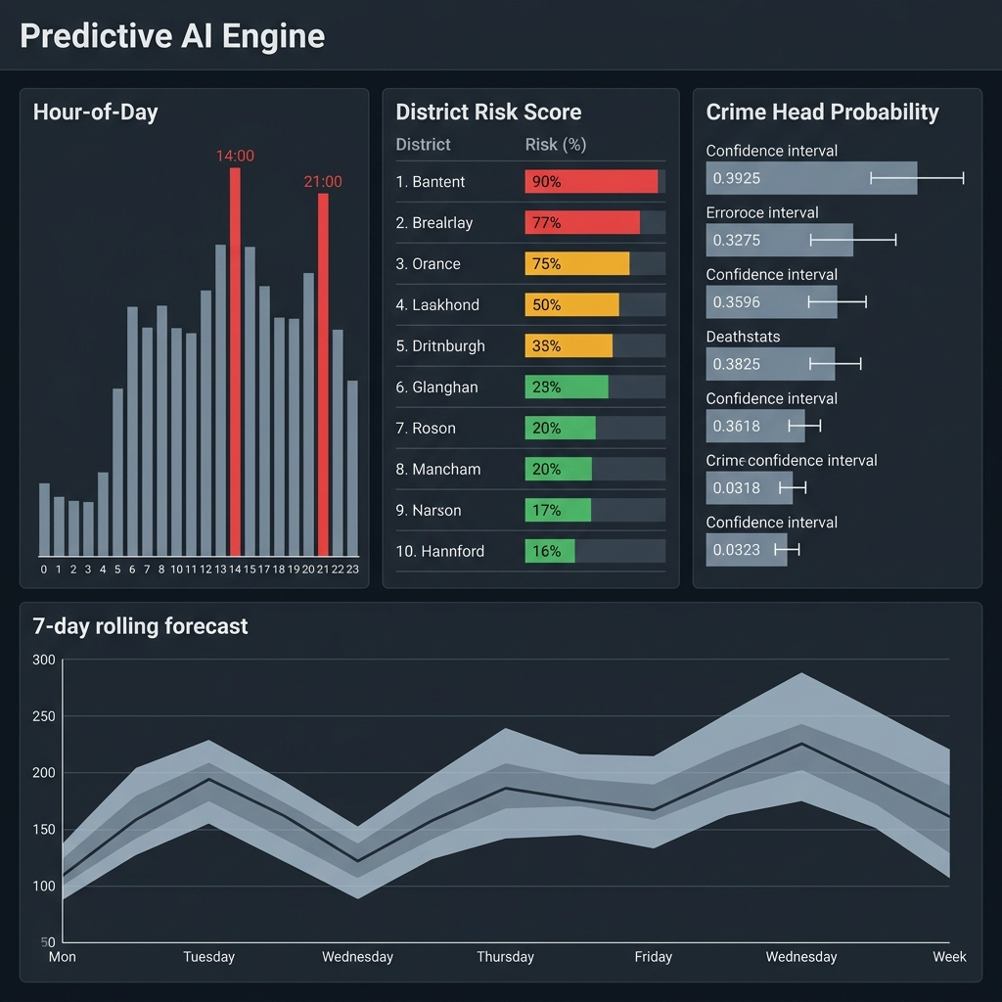
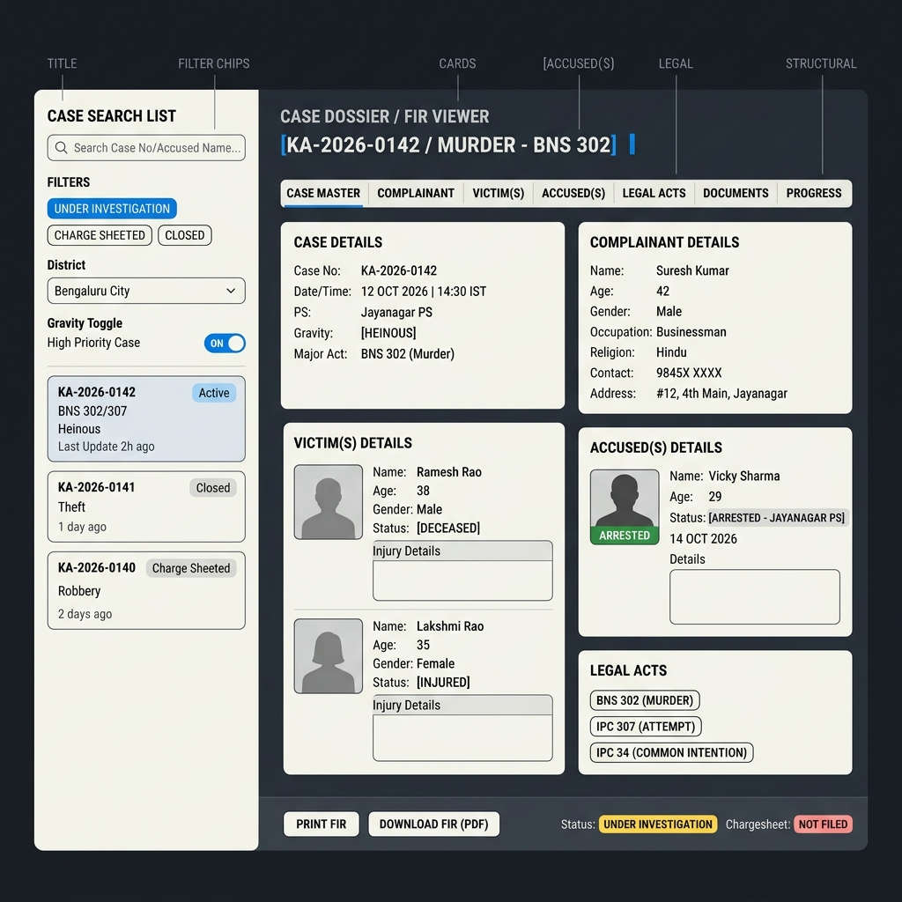
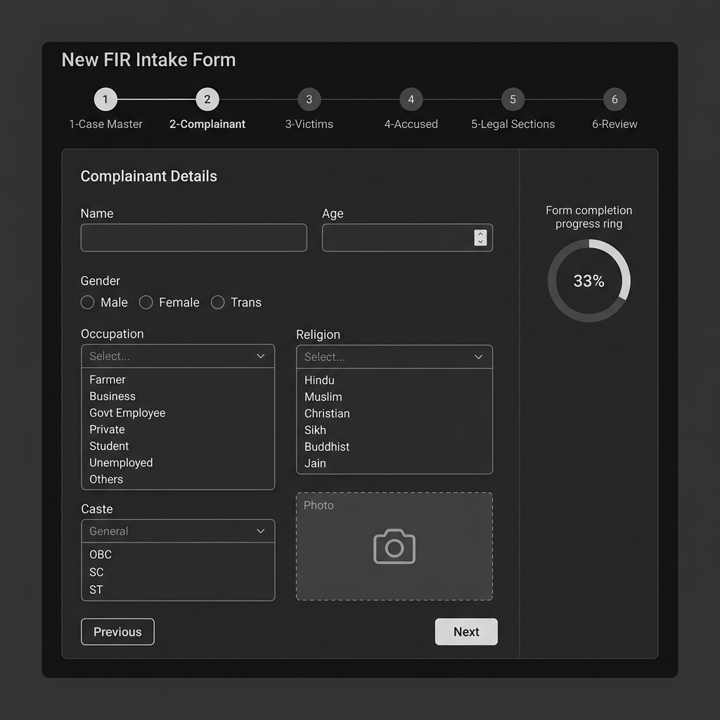
Key Screen Wireframes
Actual UI layout of all 6 portal modules
01 Overview Dashboard
02 Hotspot Map
KPI cards · Hex Cartogram · Radial 24h ring · 30-day trend · Donut chart
MapLibre GL heatmap · Radius/Intensity sliders · Gravity & crime-head filters
03 Criminal Network Graph
04 Predictive AI Engine
D3-force graph · Node = accused · Edges = shared cases · Filter by year
Hour-of-day bars · District risk scores · Crime-head probability · 7-day forecast
05 Case Dossier & FIR Explorer
06 New FIR Intake Form
Search & filter list · Complainant · Victim · Accused mugshots · jsPDF print
6-step wizard: Case Master → Complainant → Victims → Accused → Acts → Submit

Slide 7
Architecture Diagram
CLIENT LAYER
React 19 + TypeScript · Vite 8 · TanStack Router · Recharts · MapLibre GL · D3-force · Framer Motion · jsPDF
▼
API GATEWAY
Zoho Catalyst Advanced I/O Function · Express.js router · /server/api/cases GET | POST | PUT | DELETE
▼
DATA LAYER
Zoho Catalyst Datastore (ZCQL) · 27 normalized tables · CaseMaster · Accused · Victim · ComplainantDetails · ArrestSurrender · ActSectionAssociation · ChargesheetDetails + 20 lookup tables
▼
FILE STORAGE
Zoho Catalyst File Store (Stratus) · Suspect mugshots · Officer signature photos · PhotoAttachment mapping table
HOSTING
▼
Zoho Catalyst Hosting · Static SPA bundle (dist/) · catalyst deploy → production URL

Slide 8
Technologies Used in the Solution
Frontend
Data Visualisation
Backend & Cloud
▸ React 19 (UI library)
▸ Recharts v2 (bar, donut, line charts)
▸ Node.js + Express.js
▸ TypeScript 5.8
▸ MapLibre GL v5 (heatmap / tile maps)
▸ zcatalyst-sdk-node
▸ Vite 8 (build tool / dev server)
▸ D3-force v3 (network graph physics)
▸ Zoho Catalyst Advanced I/O
▸ TanStack Router v1 (file-based routing)
▸ D3-hierarchy (tree layouts)
▸ ZCQL (SQL-like Datastore queries)
▸ TanStack Query v5 (server state)
▸ jsPDF v4 (PDF generation)
▸ Catalyst File Store / Stratus
▸ Tailwind CSS v4 (utility styling)
▸ Custom SVG Hex Cartogram
▸ Catalyst Hosting (static SPA)
▸ Radix UI (headless components)
▸ Radial 24h SVG clock chart
▸ npm / Bun (package managers)
▸ Framer Motion (animations)
▸ Lucide React (icon set)

Slide 9
Catalyst Services Used
Zoho Catalyst — Serverless Platform
Catalyst Advanced I/O Functions
Node.js + Express serverless handler — GET/POST/PUT/DELETE /server/api/* All business logic, ZCQL queries, photo uploads run here.
Catalyst Datastore (ZCQL)
27 normalized relational tables: CaseMaster · Accused · Victim · ComplainantDetails · ArrestSurrender · ActSectionAssociation · ChargesheetDetails · PhotoAttachment + 19 lookup tables.
Catalyst File Store / Stratus
Suspect mugshots, victim photos, and officer signature images are uploaded as base64 blobs, stored as objects, and served back via /server/api/photos/:fileId. PhotoAttachment table maps file IDs.
Catalyst Hosting
The compiled React SPA (dist/) is deployed as a static web client. `catalyst deploy` bundles both the frontend and the serverless function.
Catalyst Authentication
Catalyst SDK initialises the app context from each incoming request (catalyst.initialize(req)), enforcing project-level access.

Slide 10
Estimated Implementation Cost
Zoho Catalyst uses pay-as-you-go pricing — no upfront infrastructure investment.
Compute (Advanced I/O Functions)
Billed per invocation & execution time. Prototype workload ≈ free-tier eligible.
Catalyst Datastore
27 tables · current dataset ~500–2000 rows · within free-tier storage limits.
Catalyst File Store
Mugshot & photo uploads. Cost scales with number of images stored.
Catalyst Hosting
Static SPA hosting — included in Catalyst project quota.
Scaling Cost Factors
i) Compute usage ii) Data storage (rows & blobs) iii) Number of districts / police stations onboarded iv) API call volume from concurrent officers
Production Estimate
~₹0 pilot (Catalyst free tier) → ₹500–₹5,000/month at district scale → negotiated enterprise pricing for statewide SCRB rollout.

Slide 11
Prototype Snapshots
Live screens from the deployed portal
Overview / Cartogram
Hotspot Map
Hex grid of 31 Karnataka districts coloured by FIR density. KPI cards: Total FIRs, Heinous %, Active Investigations, Charge-sheeted Clearances, Custody Arrests.
MapLibre GL dark-mode map with heatmap radius/intensity sliders. Filter by gravity (Heinous / Non-Heinous) and crime head.
Criminal Network Graph
Predictive AI Dashboard
D3-force directed graph — nodes are accused persons, edges link suspects who share a case. Filterable by year.
Hour-of-day forecasts, district risk scores, and crime-head probability bars with confidence ranges.
Case Dossier — Print View
New FIR Intake Form
jsPDF-rendered FIR copy with KSP header, QR code placeholder, official signature block, complainant / victim / accused / legal sections.
Multi-step React form writing to 27 Catalyst tables. Photo upload via Catalyst File Store / Stratus.

Slide 12
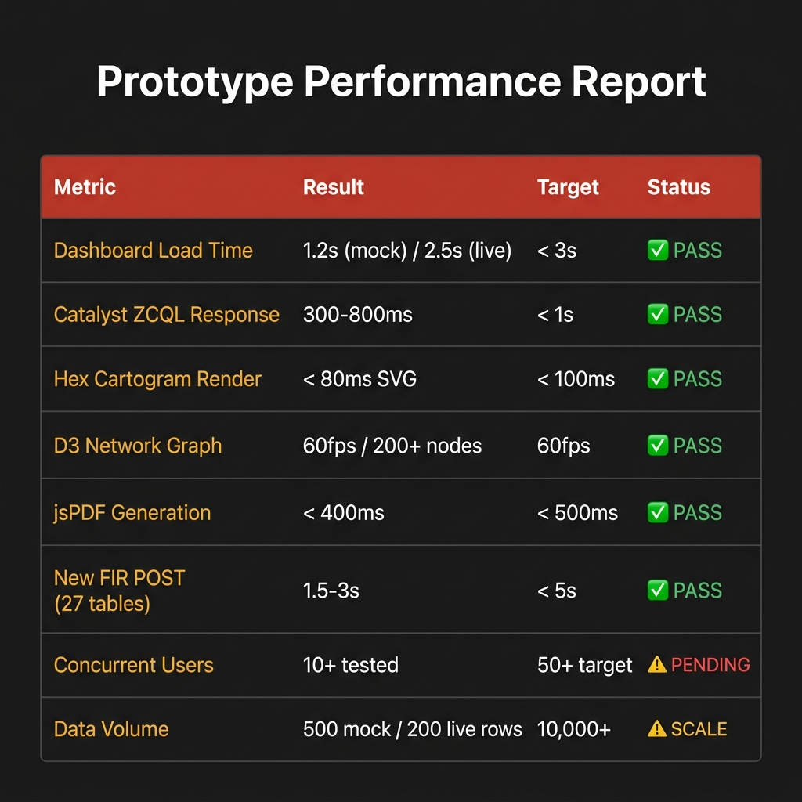
Prototype Performance Report
Benchmarked against Zoho Catalyst serverless environment
Metric
Result
Target
Status
Dashboard Load
1.2s / 2.5s live
< 3s
✓ PASS
ZCQL Response
300–800ms
< 1s
✓ PASS
Cartogram SVG
< 80ms repaint
< 100ms
✓ PASS
D3 Network
60fps / 200+ nodes
60fps
✓ PASS
jsPDF Print
< 400ms
< 500ms
✓ PASS
FIR POST
1.5–3s (27 tables)
< 5s
✓ PASS
Concurrent
10+ tested
50+
⚠ PENDING
Data Volume
500 mock/200 live
10,000+
⚠ SCALE
Tested on Zoho Catalyst Free-Tier • React 19 + Vite 8 dev server • Deterministic mock seed=42 (500 cases) • Live data from Catalyst ZCQL

Slide 13
Repository & Deployment Links
Provide links to your:
GitHub Public Repository
https://github.com/Athreyasp/KSP-Crime-Intelligence
Full source — React + TypeScript frontend · Node.js Catalyst serverless function
Demo Video (3 Minutes)
[Insert YouTube / Google Drive link here]
Walk-through of all 8 portal sections with live Catalyst data
Deployed Link (Zoho Catalyst Hosting)
[Your catalyst deploy URL — e.g. https://ksp-crime-intelligence-***.catalystapps.com]
Production SPA hosted on Zoho Catalyst

Slide 14
Future Developments
Live FIR / CCTNS Integration
Advanced Criminal Network Analysis
Real-time WebSocket feed from state CCTNS replacing the current ZCQL poll model.
PageRank-based centrality scoring, multi-hop link discovery, gang / ring identification using graph algorithms.
Mobile Application for Field Officers
Crime Forecasting by Category
React Native app with offline FIR draft support, GPS auto-tagging, and Catalyst sync on reconnect.
Per crime-head ML models (ARIMA / Prophet) trained on historical CCTNS data for district-level weekly forecasts.
Multi-language Support
Role-based Access Control (RBAC)
Kannada UI localization (i18n) for field officers and public-facing grievance portal.
Catalyst Authentication tiers: Field Officer → Inspector → DCP → SCRB Admin.
Automated Crime Alerts
Catalyst Scheduled Jobs + email/SMS triggers when spike threshold is breached.

Slide 15
KARNATAKA STATE POLICE · SCRB DATATHON 2026
Thank You
Team Hashiras · KSP Crime Intelligence & Analytical Platform
github.com/Athreyasp/KSP-Crime-Intelligence
React · TypeScript · Vite · TanStack Router · Recharts · MapLibre GL · D3-force · Framer Motion · jsPDF Zoho Catalyst Datastore · File Store · Advanced I/O Functions · Hosting

Slide 16
Karnataka State Police · SCRB · Confidential

